Slide 1
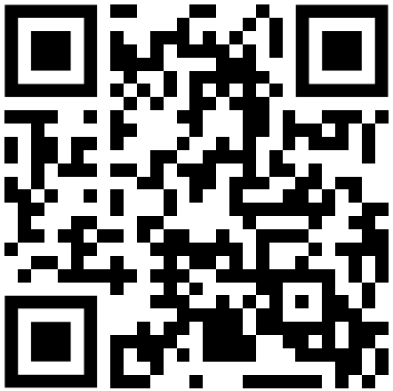
Address:
Description:
Applicant:
October 12, 2023 at 1:00 pm, in the Phoebe B. Stanton Boardroom, 417 East Fayette Street, 8th Floor. The building is ADA accessible. For the most current participation instructions, please visit: https://pc.baltimorecity.gov/2023-agendas

